Slide 1
Occam Design
TETRAS DEMO: Heating

Slide 2
TETRAS DEMO: Introduction
Objective:
To study the impact of heating with respect to known difficult in situ couplings and sequence phenomena using two small peptide sequences and three commercial activation chemistries at four different temperatures
Case Study 1:
Peptide 1-2HN-Y[Aib][Aib]FLKK-NH2-This sequence is a known difficult coupling of Aib to Aib. Coupling efficiency was monitored using RP-HPLC-MS responses corresponding to full length material versus Aib deletion. The peptides were produced at 100 µmol level
Case Study 2:
Peptide 2-2HN-LHCDGFK-Cysteamine-This sequence contains a DG within the sequence which is notorious for producing aspartimide by-products during synthesis. Synthesis utilizes a ClTrt resin which has been reported to be unstable during heating and results in lower yields. RP-HPLC-MS was used to monitor aspartimide formation and yields were recorded gravimetrically. The peptides were produced at 100 µmol level

Slide 3
TETRAS DEMO: EQUIPMENT & METHODS
RP-HPLC–MS was accomplished with a WATERS ACQUITY system equipped with a PDA detector in conjunction with a Xevo G2 QTOF high resolution mass spectrometer
Flow Rates consisted of 0.4 ml/min using a WATERS BEH C18 column, 1.7 um, 2.1 x 50 mm column dimension
Gradient method was 5-65%B-10 min , A=Water/0.1% TFA and B=Acetonitrile/0.1 % TFA
Mass Lynx software was used for RP-HPLC elucidation
220 nm wavelength was used for UV RP-HPLC measurements

Slide 4
TETRAS DEMO: REAGENTS
Reagents used
FMOC-Leu-OH-CAS#-35661-60-0
FMOC-Phe-OH-CAS#-35661-40-6
FMOC-Aib-OH- α-Aminoisobutyric acid-CAS#-62-57-7
FMOC-Tyr-OH-CAS#-71989-38-3
Fmoc-His(Trt)-CAS#-109425-51-6
FMOC-Cys(Trt)-CAS#-103213-32-7
FMOC-Asp(Otbu)-CAS#-71989-14-5
FMOC-Gly-OH-CAS#-29022-11-5
PyBOP -(Benzotriazol-1-yloxytripyrrolidinophosphonium hexafluorophosphate), CAS#- 128625-52-5
OXYMA PURE-CAS#- 3849-21-6
DIC- N,N-diisopropylcarbodiimide-CAS#- 693-13-0
DEPBT- (3-(diethoxyphosphoryloxy)-1,2,3-benzotriazin-4(3H)-one, CAS#- 165534-43-0
DIEA- Diisopropylethylamine, CAS#- 7087-68-5
Piperidine-CAS#- 110-89-4
DMF- N,N'Dimethylformamide-CAS# 68-12-2
Knorr Resin
Cysteamine CLTRT resin
Trifluoracetic Acid(TFA)- CAS#- 76-05-01
Triisopropylsilane(TIS)-CAS#- 6485-79-6
Tert-Butyl methyl Ether -CAS#- 1634-04-4

Slide 5
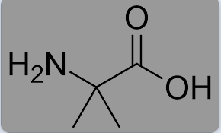
TETRAS DEMO: Case Study 1
Case Study 1: 2HN-Y[Aib][Aib]FLKK-NH2- MW=866.76 AMU
2-aminoisobutyric acid(Aib) is a hindered amino acid(pictured below) that has been known to be very difficult to couple to itself. The dimethyl groups on the alpha carbon make the nucleophilic amino attack on the activated carboxylate very hindered
Heating during the coupling has been known to prevent this hinderance and increases the kinetics of this coupling
The sequence was synthesized using the TETRAS with four different temperatures with three activators that are very well known in the peptide community, PyBOP/DIEA, DIC/Oxyma and DEPBT/DIEA
All syntheses were accomplished using 10 min double coupling, 20 min(10 x 2) FMOC deprotections with subsequent washings after major steps
In this case a Knorr resin was used to provide a carboxy amide
Peptides were TFA deprotected and cleaved from solid support using 90% TFA, 8% TIS and 2% water. Precipitated with Tert-Butyl methyl Ether, centrifuged and washed 3X with ether and then dried and reconstituted for LCMS analysis

Slide 6
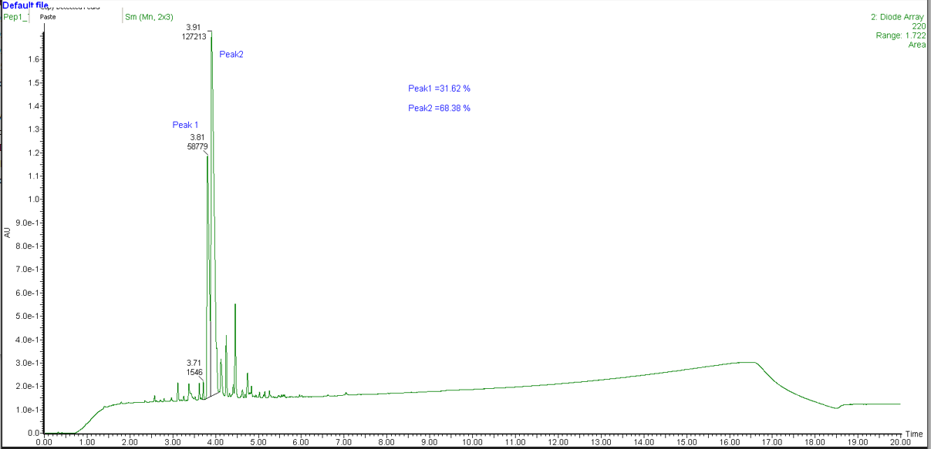
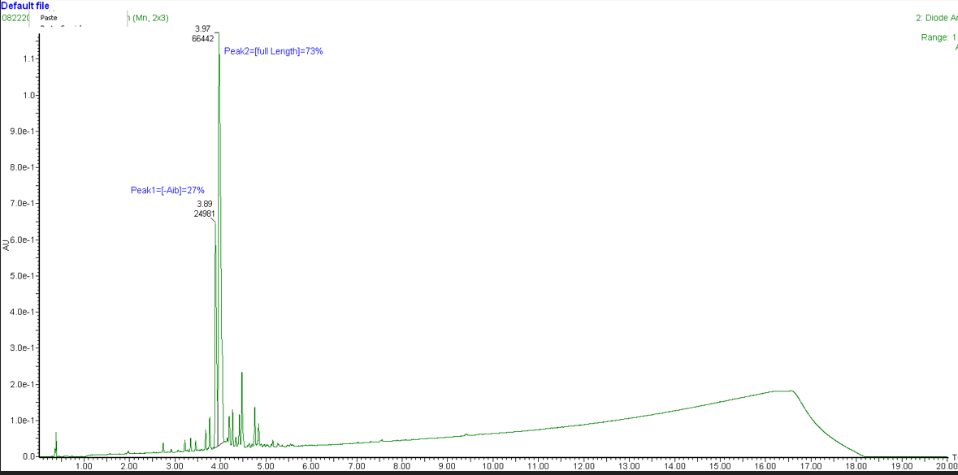
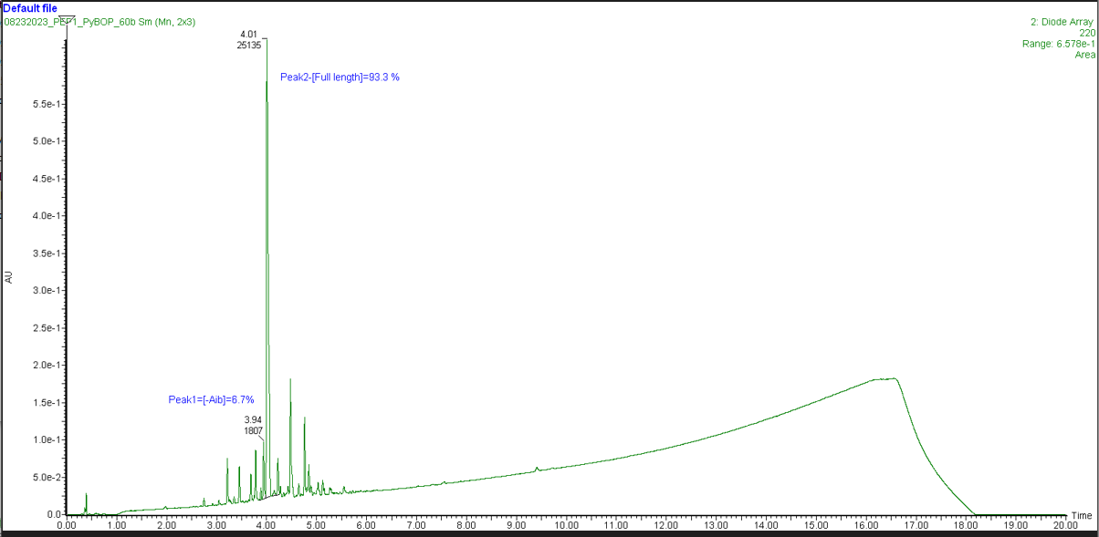
TETRAS DEMO: PyBOP/DIEA Activation
2HN-Y[Aib][Aib]FLKK-NH2 – RP-HPLC traces at different temperatures ©

Slide 7
TETRAS DEMO: PyBOP Activation
2HN-Y[Aib][Aib]FLKK-NH2 –Temperature Vs Relative % By RP-HPLC

Slide 8
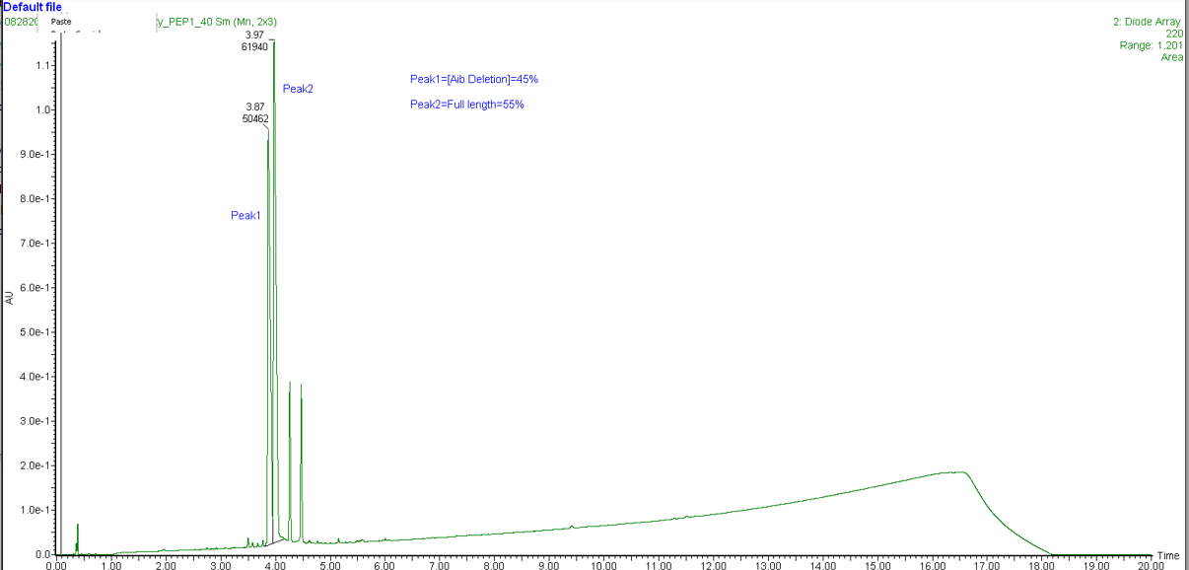
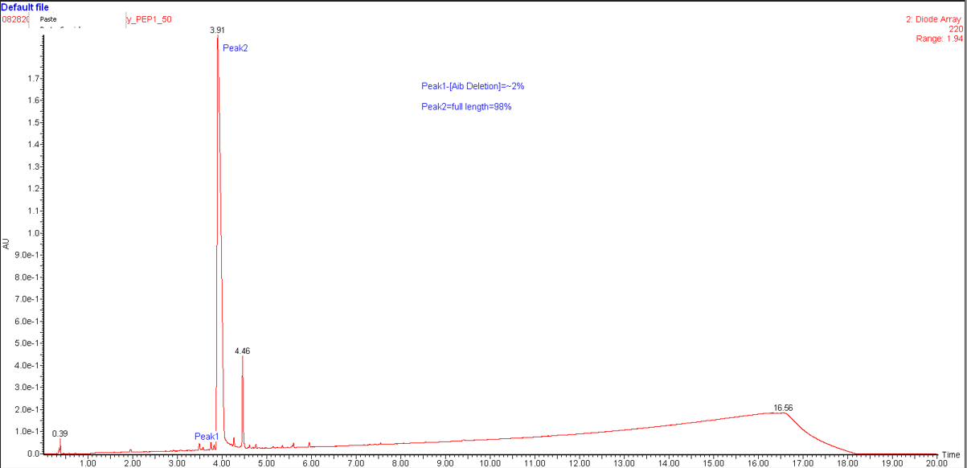
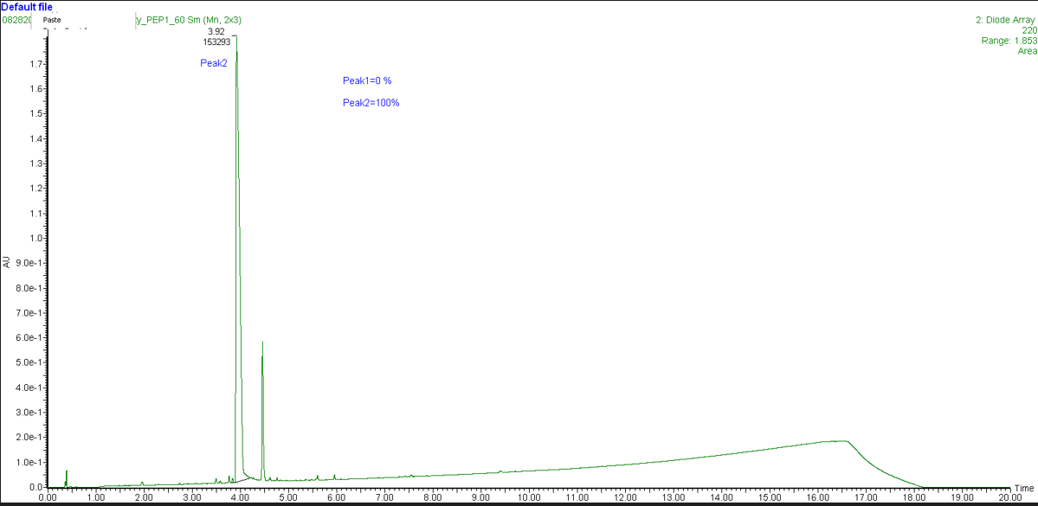
TETRAS DEMO: DIC/Oxyma Activation
2HN-Y[Aib][Aib]FLKK-NH2 – RP-HPLC traces at different temperatures ©

Slide 9
TETRAS DEMO: DIC/Oxyma Activation
2HN-Y[Aib][Aib]FLKK-NH2 - Temperature Vs Relative % By RP-HPLC

Slide 10
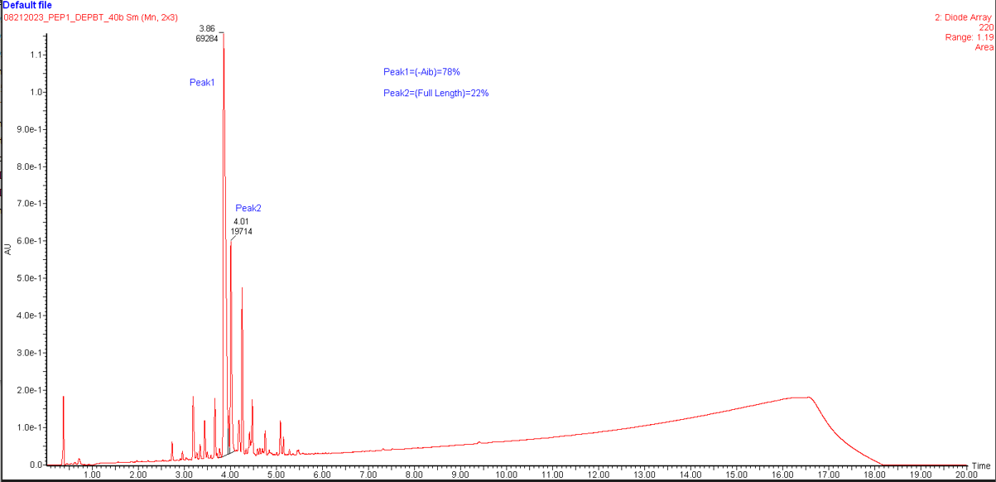
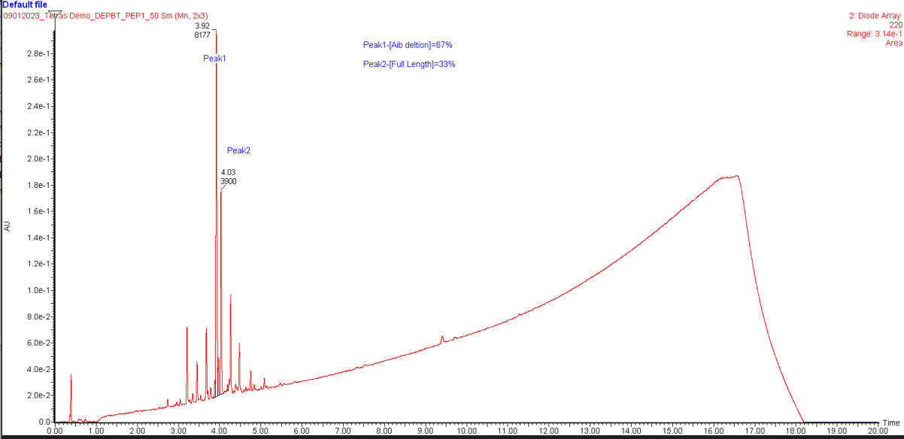
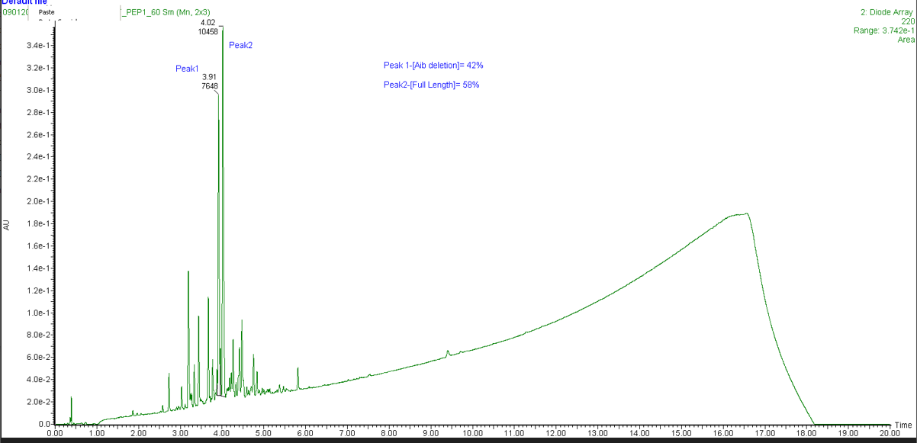
TETRAS DEMO: DEPBT/DIEA Activation
2HN-Y[Aib][Aib]FLKK-NH2 – RP-HPLC traces at different temperatures ©

Slide 11
TETRAS DEMO: DEPBT Activation
2HN-Y[Aib][Aib]FLKK-NH2- Temperature Vs Relative % By RP-HPLC

Slide 12
TETRAS DEMO: Results-Case Study1
Heating showed significant improvement in formation of the full-length peptide
DIC/Oxyma coupling is shown to be the best activation chemistry in this scenario with essentially no deletion product detected at 50 and 60 degrees
PyBOP coupling is also shown to work very well with heating at 60 degrees with very minimal deletion product
DEPBT showed to be the worse activation scheme with significant amount of deletion detected at 60 degrees although improvements were observed with increasing temperature

Slide 13
TETRAS DEMO: Conclusion-Case Study 1
TETRAS heating is showing great improvement over room temperature chemistry
There is differences in product quality with different activation with TETRAS heating, in this case the DIC/Oxyma looks to produce the highest quality product for this sequence at 50-60 degrees
Although this case study focused on Aib deletion no significant finding were revealed for other heating phenomena, including premature FMOC removal, reagent degradation or delirious side reactions
DEPBT showed to be the worse activation scheme with significant amount of deletion detected at 60 degrees although improvements were observed with increasing temperature
The contrast between room temperature coupling and elevated temperature is outstanding, ie… the PyBOP showed the best full-length product at room temperature where DIC/Oxyma was very inefficient but increasing the temperature showed DIC/Oxyma to be the superior

Slide 14
TETRAS DEMO: Case Study 2
Case Study 2: PEP2-2HN-LHCDGFK-Cysteamine, MW=877.36 AMU
Aspartimide formation results from a base induced attack of the backbone nitrogen of an adjacent residue on the side chain carboxylate of the next amino acid forming several different adducts that render the product useless, normally a Aspartic acid or Asparagine residue next to a glycine but aspartimide formation has been observed in other sequences ( see figure on next slide)
This phenoma that has burdened Peptide Chemist over the ages and has shown greater interest with the advent of heating for peptide synthesis
This phenoma consist of three adducts, Succinimide formation (-18 AMU) , Iso-Aspartic acid (mass neutral) and Piperidine adduct(+67 AMU), this study just focuses on the Succinimide formation and Piperidine adduct because the Iso-aspartic acid side product formation is difficult to assess via mass spectrometry although it should be noted that succinimide formation can be hydrolyzed to Iso-aspaspartic acid moiety and co-elute with the product
The sequence was designed to produce aspartimide formation by products and most likely results in racemic mixtures
All syntheses were accomplished using 10 min double coupling, 20 min(10 x 2) FMOC deprotections with subsequent washings after major steps
In this case a Cysteamine ClTrt resin was used to provide a a C terminal thiol. It has been reported that unwanted lability of ClTrt resins from the solid support have been observed using heating in peptide synthesis, monitoring yield lost compared to room temperature syntheses was recorded
Peptides were TFA deprotected and cleaved from solid support using 90% TFA, 10% TIS. Precipitated with Tert-Butyl methyl Ether, centrifuged and washed 3X with ether and then dried and reconstituted for direct LCMS analysis

Slide 15
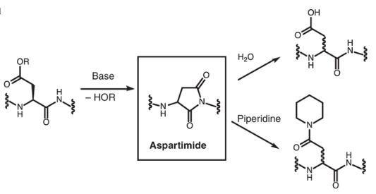
TETRAS DEMO: Case Study 2
Case Study 2: PEP2-2HN-LHCDGFK-Cysteamine-Cltrt Resin

Slide 16
TETRAS DEMO: PyBOP Aspartimide Formation
PEP2-2HN-LHCDGFK-Cysteamine- Temperature Vs Relative % By RP-HPLC

Slide 17
TETRAS DEMO: DIC/Oxyma Aspartimide Formation
PEP2-2HN-LHCDGFK-Cysteamine- Temperature Vs Relative % By RP-HPLC

Slide 18
TETRAS DEMO: DEPBT Aspartimide Formation
PEP2-2HN-LHCDGFK-Cysteamine- Temperature Vs Relative % By RP-HPLC

Slide 19
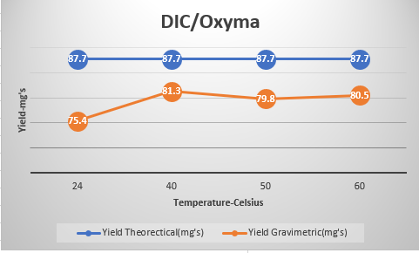
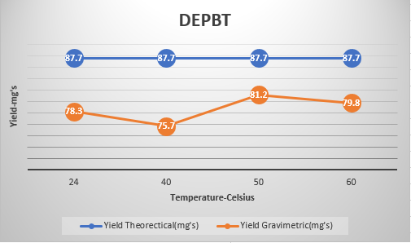
TETRAS DEMO: -Yield of crude powder
PEP2-2HN-LHCDGFK-Cysteamine

Slide 20
TETRAS DEMO: Results-Case Study2
Aspartimide formation increased with temperatures for all chemistries
Higher temperatures showed unacceptable levels of aspartimide formation
No other modifications were seen with production of this sequence including His modification or thiol transformation
An examination of the gravimetric yields showed no impact from heating or removal of Chlorotrityl solid support during synthesis

Slide 21
TETRAS DEMO: Final Conclusions
Heating does show dramatic impact on coupling efficiency
The choice of the activator does matter relative to heating coupling efficiency
Very difficult in situ couplings are overcome with heating on the TETRAS
Increasing temperature will promote aspartimide formation and it is recommended that known reagents and monomers be used to suppress this by-product at higher temperatures
Higher temperatures showed no decrease in yield or erroneous FMOC removal or premature release from Cltrt resin

